Slide 1
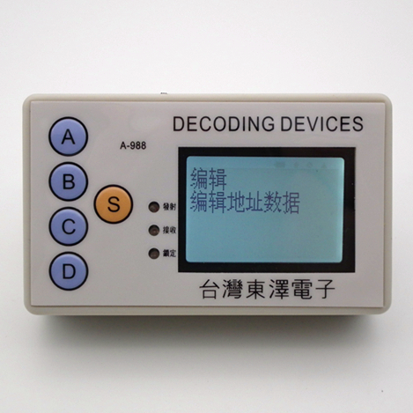
MINI PROJECT INTERSHIP
Himani Chauhan
Section:- ECE-2
Roll no. 1802731068

Slide 2
VHSIC-HDL
VHDL stands for very high-speed integrated circuit hardware description language. It is a programming language used to model a digital system by dataflow, behavioral and structural style of modeling. This language was first introduced in 1981 for the department of Defence (DoD) under the VHSIC program.

Slide 3
DESCRIBING DESIGN
In VHDL an entity is used to describe a hardware module. An entity can be described using:
Entity declaration
Architecture
1.dataflow
2.structural
3.behavioral

Slide 4
ENTITY DECLARATION
It defines the names, input, output signals and modes of a hardware module.
SYNTAX: entity entity _ name is
port( a,b,c: in std_logic;
d: out std_logic);
end entity_name;
An entity should start with “entity” keyword and end with “end” keyword. The direction will be input , output or inout type

Slide 5
ARCHITECTURE
Architecture can be described using dataflow , structural or mixed modeling.
SYNTAX :- architecture architecture_ name of entity namearchitecture_ declarative part;
begin
statements;
end architecture name;
Here, we should specify the entity name for which we are writing the architecture body. The architecture statements should be inside the ‘begin’ and ‘end’ keyword. Architecture declarative part may contain variables, constants, or component declaration.

Slide 6
BEHAVIORAL MODELING
In this modeling style, the behavior of an entity as set of statements is executed sequentially in the specified order. Only statements placed inside a PROCESS, FUNCTION, or PROCEDURE are sequential.
PROCESSES, FUNCTIONS, and PROCEDURES are the only sections of code that are executed sequentially.
One important aspect of behavior code is that it is not limited to sequential logic. Indeed, with it, we can build sequential circuits as well as combinational circuit.

Slide 7
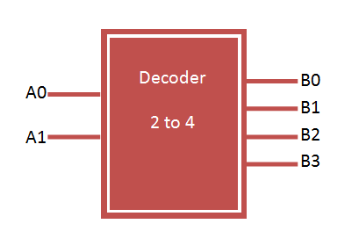
What is decoder?
A decoder is an electronic circuit with multiple input and multiple output signals, which converts every unique combination of input states to a specific combination of output states. It is a combinational logic circuit that converts binary information from the n coded inputs to a maximum of 2^{n} unique outputs.

Slide 8
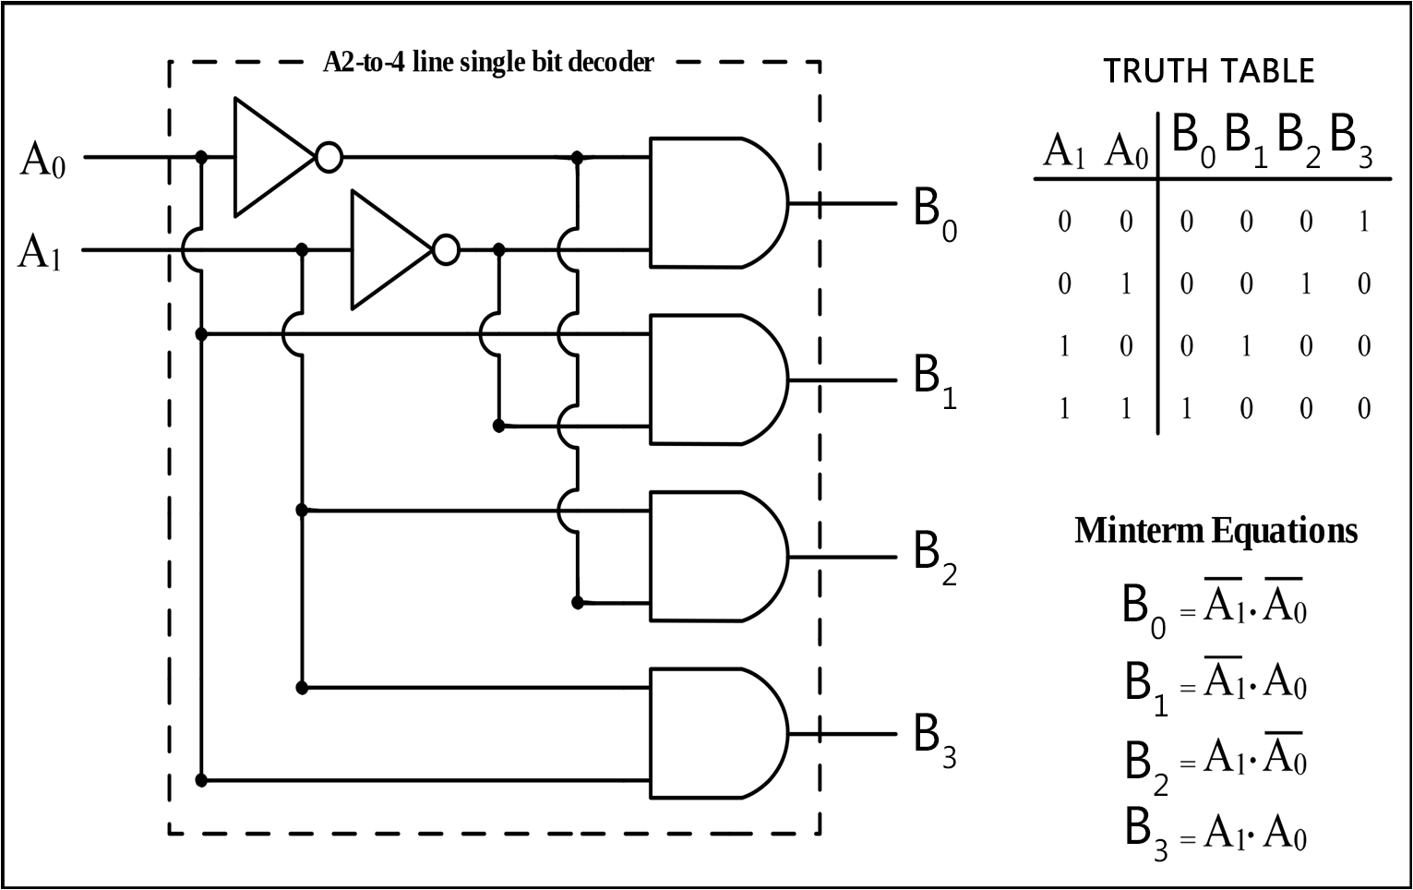

Slide 9
VHDL Code for 2 to 4 decoder using case statement
library IEEE;
use IEEE.STD_LOGIC_1164.all;
entity decoder is
port(
A : in STD_LOGIC_VECTOR(1 downto 0);
B : out STD_LOGIC_VECTOR(3 downto 0)
);
end decoder;
architecture behaviour of decoder is
begin
process(A)
begin
case A is
when "00" => B <= "0001"; when "01" => B <= "0010"; when "10" => B <= "0100"; when "11" => B <= "1000";
end case;
end process;
end behaviour;

Slide 10
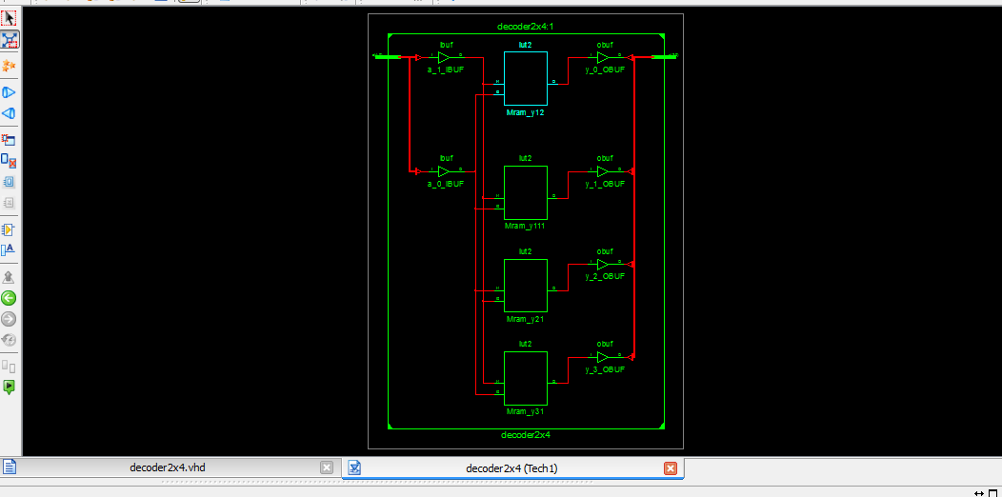
RTL SCHEMATIC

Slide 11
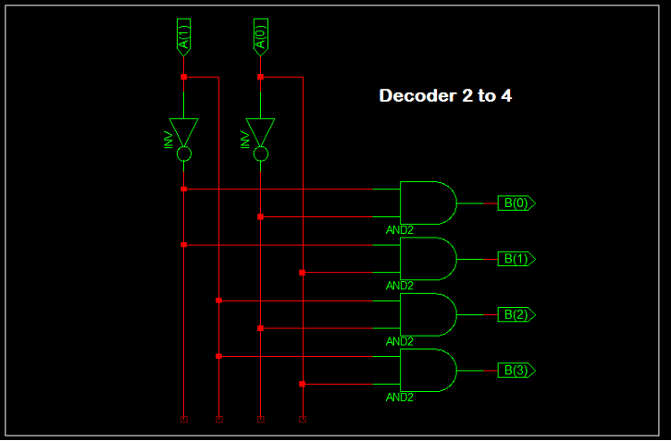

Slide 12
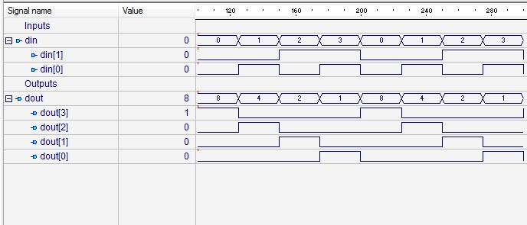
Wave form

Slide 13
APPLICATIONS OF DECODER
The Decoders were used in analog to digital conversion in analog decoders.
Used in electronic circuits to convert instructions into CPU control signals.
They mainly used in logical circuits, data transfer.
Used for data distribution i.e. demultiplexing.

Slide 14
THANK YOU

